Slide 1
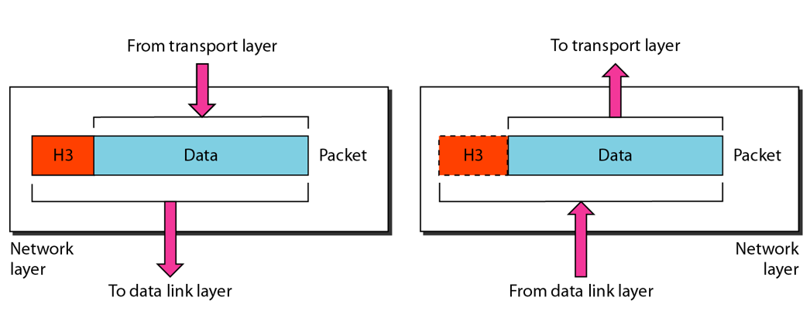
The Network Layer

Slide 2

Network Layer
Switch
S
R
Sender and receiver in the same network
Use MAC addresses
Sender and receiver in the same network: MAC addresses
Problem: Sender and receiver in different networks: Cannot use MAC addresses
Solution: IP address
MAC address = Local address
IP address = Universal address
IP address = Global address
Sender and receiver in different networks
Use IP addresses
Switch
S
Router
Router
Switch
R

Slide 3
Physical and Logical Address
Each computer on the Internet has two addresses:
Physical address/MAC address/Hardware address
Fixed address, hardcoded on the Network Interface Card (NIC)
Different for different network type (e.g. Ethernet card, WiFi card)
Useful within or inside a network only
Logical address/IP address/Virtual address
Exists in software
Given by the network provider or your organization (usually temporary)
Useful outside a network (e.g. to reach another computer on the Internet, anywhere in the world)

Slide 4
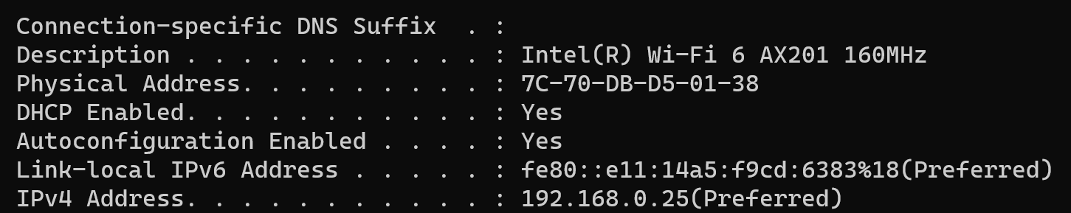
Example

Slide 5
Example
Suppose we have used our web browser to access a web page located on our company’s web server
Consider that the following are the details of the two computers
Computer | IP Address | MAC Address | Port Number
Web server | 192.168.5.1 | 5-5-5-5-5-5 | TCP 80
Laptop | 192.168.5.2 | 6-6-6-6-6-6 | TCP 5091

Slide 6
How will the Web Server Respond?
Layer 7 obtains the data in the form of the HTML document.
Layer 6 adds information about the formatting.
Layer 5 adds information required to create a session between the web server and the web browser on the laptop.
Layer 4 adds the transport protocol and the source and destination port numbers, in this case TCP (it's a unicast) and port 80 (HTTP).
Layer 3 adds the source and destination IP addresses, in this case a source of 192.168.5.1 and a destination of 192.168.5.2.
Layer 2 learns the destination MAC address and adds the source and destination MAC addresses, in this case, a source of 5-5-5-5-5-5 and destination of 6-6-6-6-6-6.
Layer 1 converts the entire package into bits and sends it across the network to the laptop.

Slide 7
How will the Laptop Handle this?
Layer 1 receives the bits in electrical format, converts them to be read by layer 2, and hands them to layer 2.
Layer 2 examines the destination MAC address to see whether it is addressed to it, sees the MAC address of 6-6-6-6-6 (its own), drops that part of the transmission, and hands the remaining data to layer 3.
Layer 3 examines the destination IP address to ensure that it is its own (192. 168.5.2), drops that part, and hands the rest of the package to layer 4.
Layer 4 examines the destination port number (port 5091), alerts the browser that HTTP data is coming in, drops that part, and hands the rest of the package to layer 5.
Layer 5 uses the information that was placed on this layer by the web server to create the session between the web server and the web browser and then hands the rest of the information to layer 6.
Layer 6 performs any format translation that may be required and hands the remaining data (the HTML document) to layer 7.
The layer 7 application (the web browser) receives the HTML document and opens the document in the browser window.

Slide 8
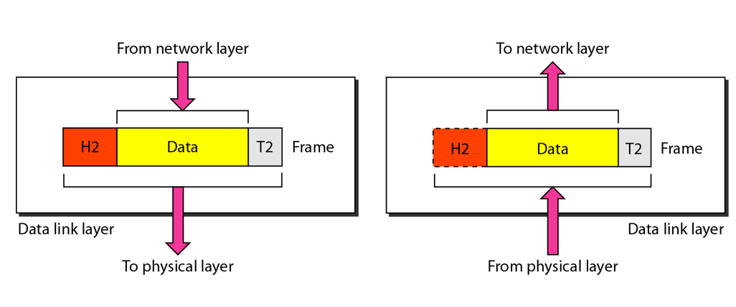
The Data Link Layer

Slide 9
Data Link Layer
Responsible for delivery of packets between two hosts connected to the same physical network (hop-to-hop – see next slide)
Cannot work across networks
Uses frames
Physical addressing: Adding sender’s and receiver’s physical addresses (also called MAC addresses) to the frame header
LAN/WAN operates at this layer (e.g. Ethernet or WiFi)
What if we know the IP address of a computer but do not know its MAC address?
Use Address Resolution Protocol (ARP)

Slide 10
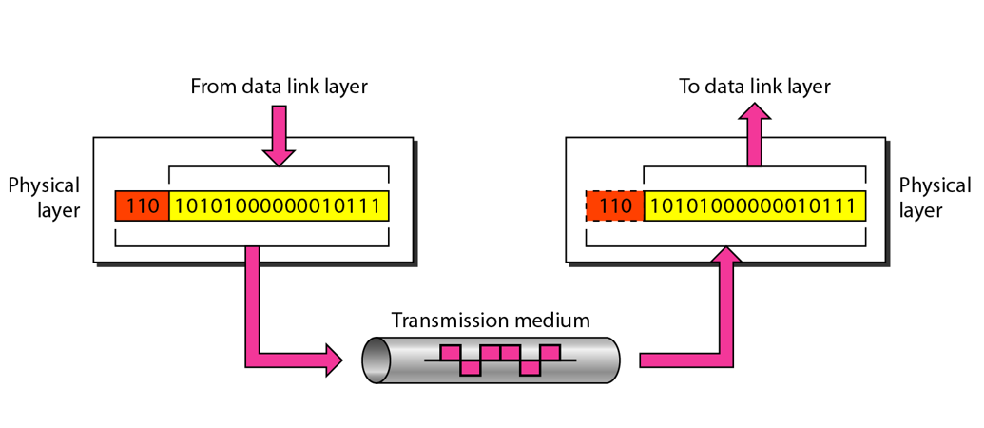
The Physical Layer

Slide 11
Physical Layer Functions
Carries the data (0s and 1s) in the form of signals
Signals can be electric, optical, or wireless

Slide 12
TCP/IP

Slide 13
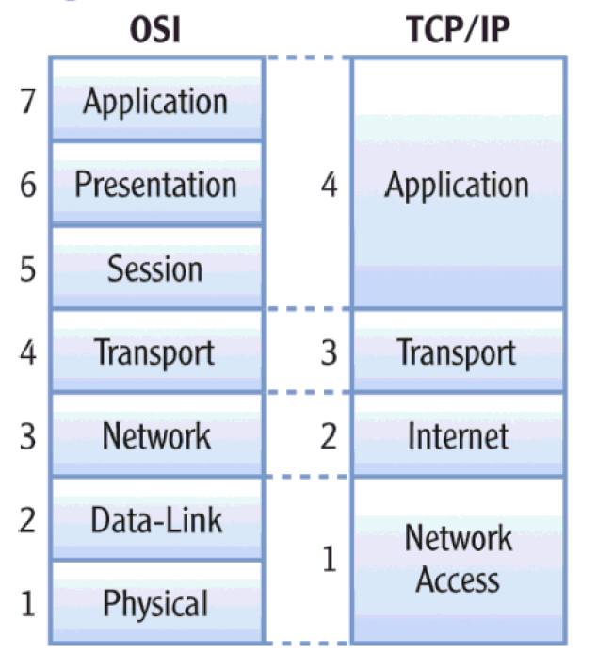
Basics of TCP/IP
TCP/IP protocol suite: Came before OSI
Has 4 layers, not 7
Sometimes it is also called a 3-layer model

Slide 14
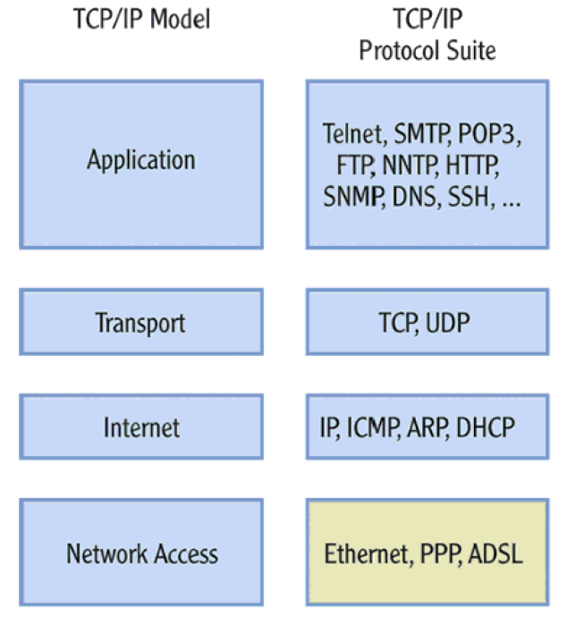
Protocols within Each TCP/IP Layer

Slide 15
Transport Layer Protocols
Transmission Control Protocol (TCP)
Reliable protocol
Guaranteed delivery
Uses connections, acknowledgements
Used for text-based data
User Datagram Protocol (UDP)
Unreliable protocol
No guarantee of delivery
No connections, no acknowledgements
Useful for audio, video or wherever we need speed but not guarantee

Slide 16
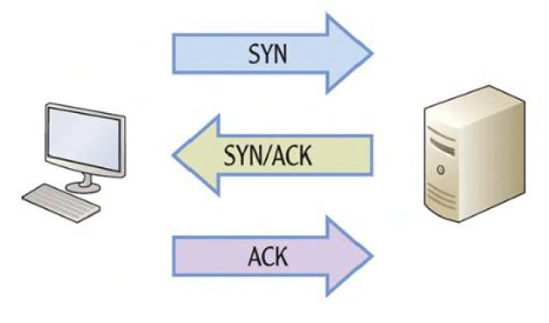
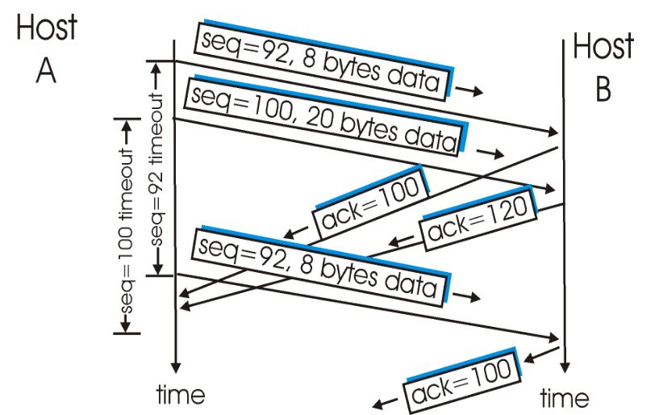
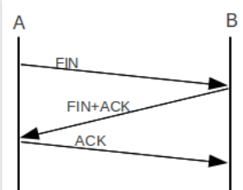
TCP – Connection Management
Connection establishment
Data transfer
Connection termination

Slide 17
UDP
No connection
No acknowledgement
No retransmissions in the case of errors

Slide 18
Internet Layer
Provides logical addressing (IP addresses)
Performs routing
Provides an IP datagram format (See next slide)

Slide 19
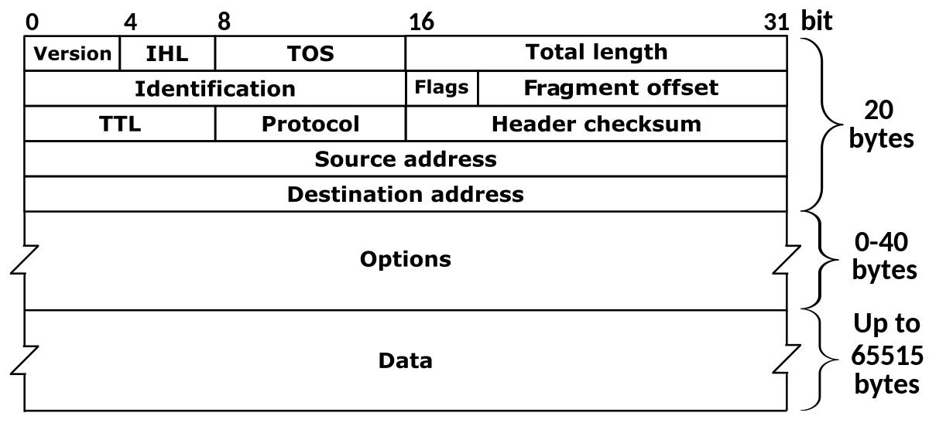
IP Datagram Format

Slide 20
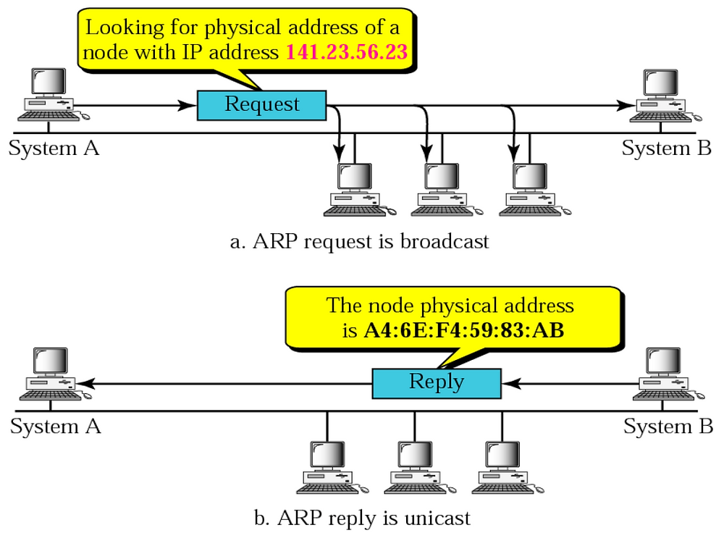
Address Resolution Protocol (ARP)
Input: IP address of a computer
Output: Its MAC address

Slide 21
Internet Control Message Protocol (ICMP)
IP is
Connectionless
Unreliable
Unacknowledged
Internet Control Message Protocol (ICMP): Helps IP deal with problems
Example:
Machine A sends a packet to Machine B, but somehow machine B is not reachable
A router that knows this discards the packet and sends an ICMP error to Machine A

Slide 22
ICMP Message Types
Error-reporting messages
Used to report problems
Query messages
Used for gaining information
Example: Computer A pings computer B … Ping = Send test packets … Computer B acknowledges

Slide 23
IP Addressing and Routing

Slide 24
IP Address
An IP address has two parts:
Network Id: Identifies which network it belongs to
Host Id: On a given network, what is the host number
Examples:
This notation is called as dotted decimal notation
Some portion of the network id is reserved to indicate class of IP address
Hence, this is called as classful addressing
14.22.130.89
143.1.99.204
193.56. 78.21

Slide 25
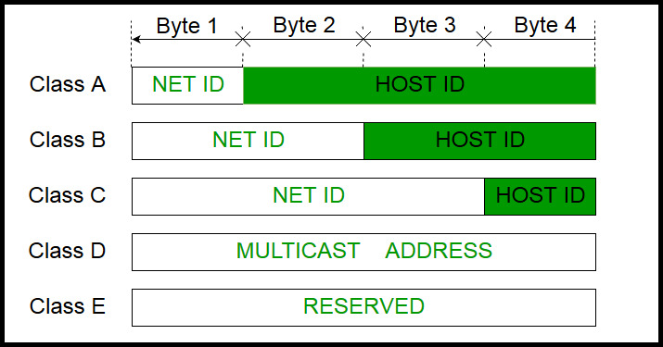
IP Address Classes

Slide 26
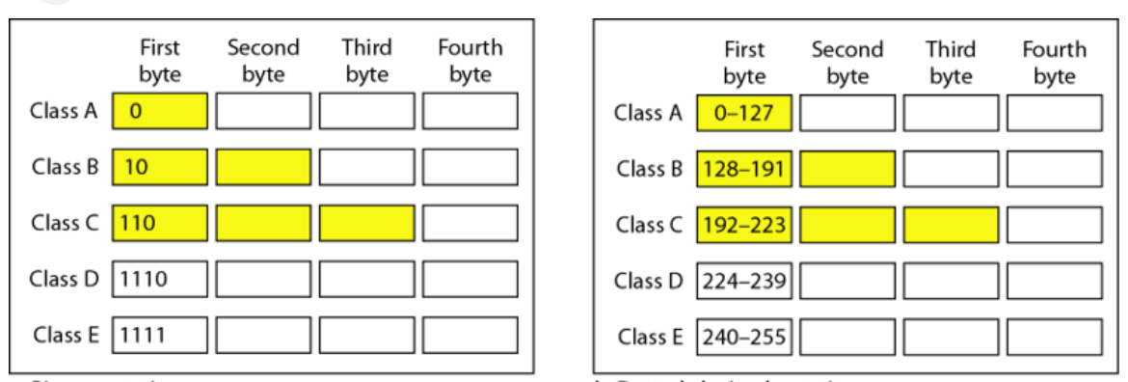
Classful Addressing

Slide 27
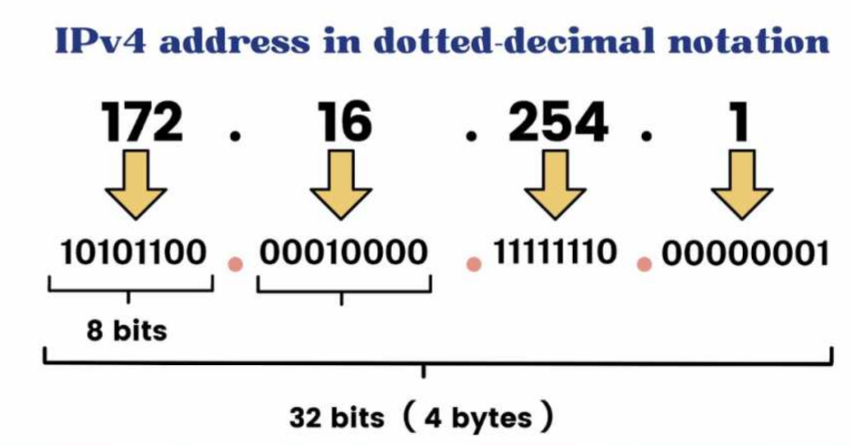
Dotted Decimal Notation

Slide 28
Private/Local/Internal IP Addresses
IP address classification: Public/External IP addresses (Accessible on the Internet) and Private/Local/Internal (Known only inside a network, so can repeat in different networks)
Some address ranges are reserved as private IP addresses:
Class A: 10.0.0.0 to 10.255.255.255
Class B: 172.16.0.0 to 172.31.255.255
Class C: 192.168.0.0 to 192.168.255.255

Slide 29
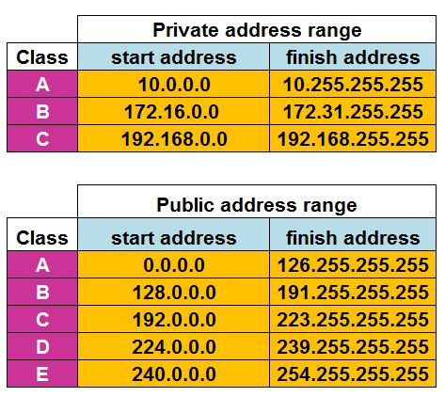
Range of IP Addresses in Each Class

